Slide 1
Programming Entry
Team Weyburn:
Sahaj Singh, Daniel Yu, Yashdeep Singh, Nicholas Mah

Slide 2
Overview
Our prompt
Designing our project
Process
Difficulties faced
Results
Live demo
Questions
Conclusion

Slide 3
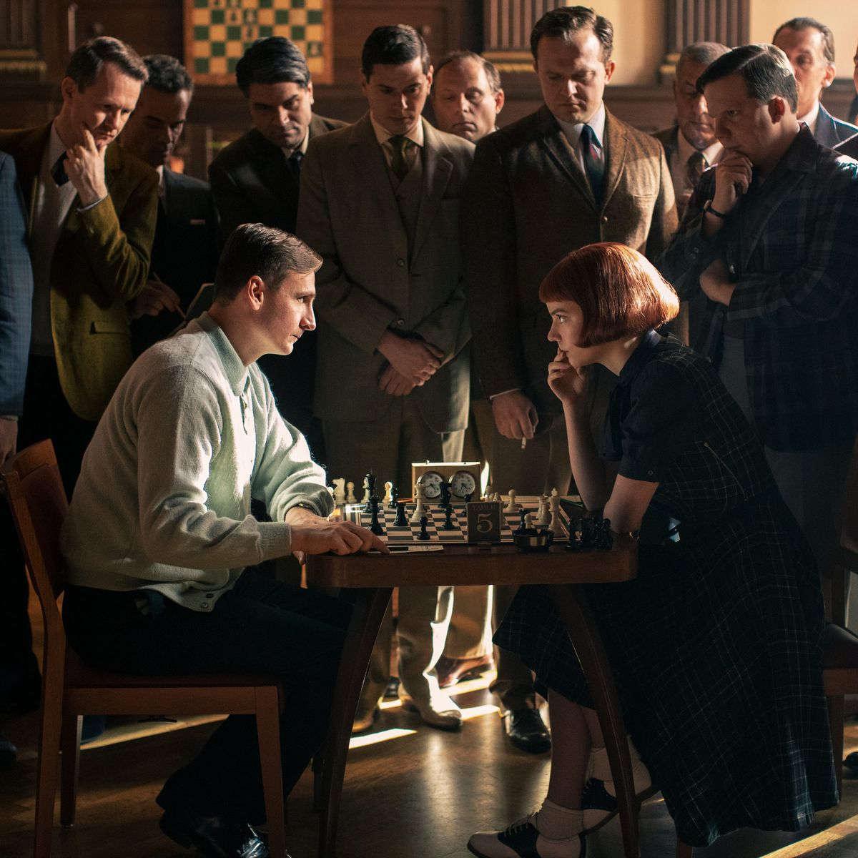
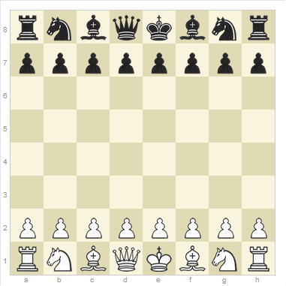

Our Prompt
In this competition, we were tasked with creating a modified digital version of the famous game known as Chess to help people adapt to the “new normal” set by the Covid-19 pandemic.
This digital version can be played by your family and friends even if they live thousands of kilometers away.

Slide 4

Platforms
Our language of choice is Python, as we were able to take advantage of its vast number of libraries, such as pygame.
We used Git as a platform to sync our work and communicate.

Slide 5
Process
We used pygame to make the game window.
Our code uses matrices to make the different game board sizes needed, such as 10x10, 12x12 etc.
We placed variables within the matrix to represent different pieces, for example, br would stand for black rook

Slide 6
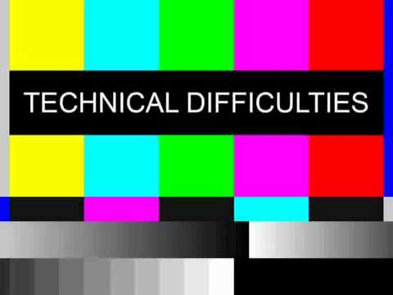
Difficulties
Unable to figure out how to implement servers
Unable to program the chess pieces to move via user input
Unable to program the game in such a way that would allow the user to choose the placement of the vanguard pieces

Slide 7
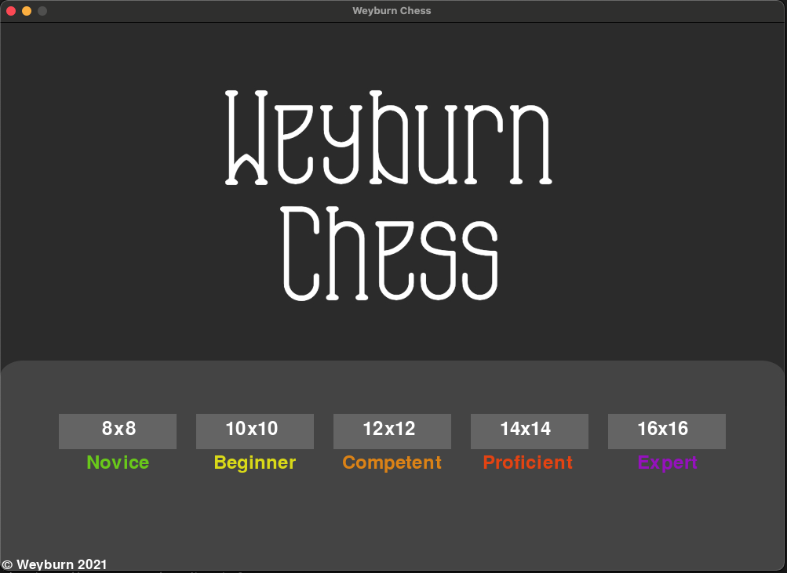
Results
We were able to use pygame to create a GUI window.
The user is also able to choose what size board to play on at the start on the opening page of the game. We were able to use matrices to make the different board sizes such 8x8 and 16x16.
We created 50x50 px images for the chess pieces.

Slide 8
Live Demo

Slide 9
Questions

Slide 10
The End

